Slide 1
[NAME OF STUDENT]
[Student]
Portfolio
[DATE CREATED]
[NAME OF PRIMARY SCHOOL]

Slide 2
What I’ve accomplished
[NAME OF STUDENT]
(Motivation) Good morning, everyone. My name is [Your Name], and today I'm excited to present my amazing project I've developed using Pygame. The motivation behind this project was to create an interactive and educational game that sparks curiosity and helps children learn about different fruits in a fun and engaging way.
(Define Problem) My problem statement is to design a game that tests kids' reactions and ability to identify various fruits quickly. The aim is to create an enjoyable learning experience that enhances their knowledge of fruits while also sharpening their cognitive skills.
(Ideate Approach) To address this challenge, I ideated a concept where colorful images of fruits would appear randomly on the screen. The goal is for the players to identify each fruit as quickly as possible, promoting swift thinking and visual recognition. To add an extra layer of excitement, I incorporated a scoring system that rewards accuracy and speed.
(Create Solution) Leveraging the Pygame library, I implemented the solution, which consists of a dynamic spawning mechanism for fruit images and a responsive user interface. Each correct identification earns points, while a timer adds an element of urgency. If the player successfully identifies a certain number of fruits within the given time or achieves a high score, they progress to the next level. The game also includes a defined game over condition to provide feedback and encourage replayability. The result is a functional and visually appealing game that aligns with the initial goal of providing an enjoyable learning experience for children.
2
Notes:
Poppins Light – 18 size

Slide 3
[NAME OF STUDENT]
Process Flow
Create an interactive game to test kids' reactions in identifying fruits.
Define Problem
Develop a concept where colorful fruits pop up on the screen, and the player must quickly click on the correct fruit. Utilize Pygame for graphics and event handling.
Ideate Approach
Using Pygame, the solution involves a main game loop where random fruits appear on the screen, and the player earns points for correctly clicking on them within a time limit. Implement a scoring system and progressively increase difficulty by speeding up fruit appearances.
Create
Solution
3
Notes:
Poppins Light – 18 size

Slide 4
[NAME OF STUDENT]
State Flow
Scoreboard
This flowchart shows how the transition between the different states. For instance, after seeing the scoreboard, players can choose to start their game and it will naturally move from ready to question to answer for the player to write an answer. Results will be shown immediately. A final winner screen will show who won the game.
Ready
Gameplay
Result
Winner
4
Notes:
Poppins Light – 18 size

Slide 5
[NAME OF STUDENT]
Python Concept
Pygame is a set of Python modules designed for writing video games. It provides functionality for creating windows, handling events like key presses, and drawing graphics on the screen.
Pygame
Random library provides functions for generating random numbers. This can be useful for scenarios where randomness is required, such as selecting questions or shuffling elements in a game.
Random
Time.sleep() function causes the program to pause for a specified number of seconds. It's commonly used to introduce delays in code execution, which can be useful in scenarios like creating countdowns or simulating time-based events.
Time.Sleep
5
Notes:
Poppins Light – 18 size

Slide 6
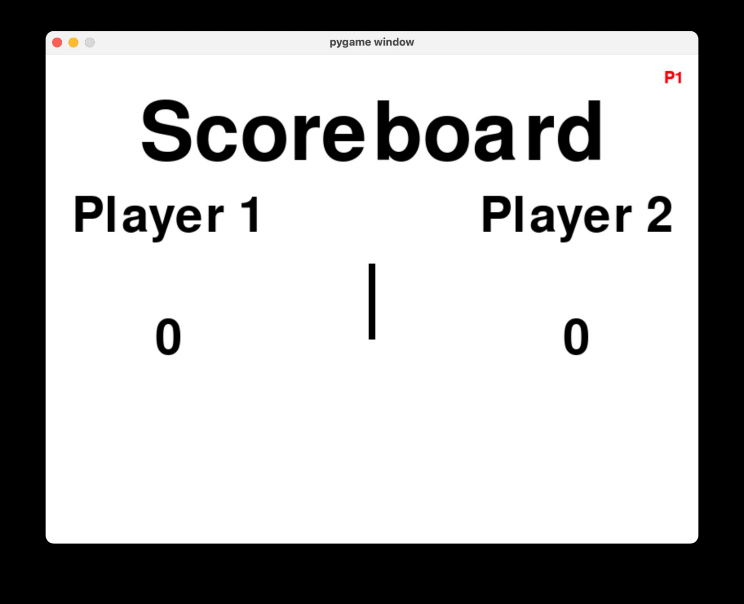
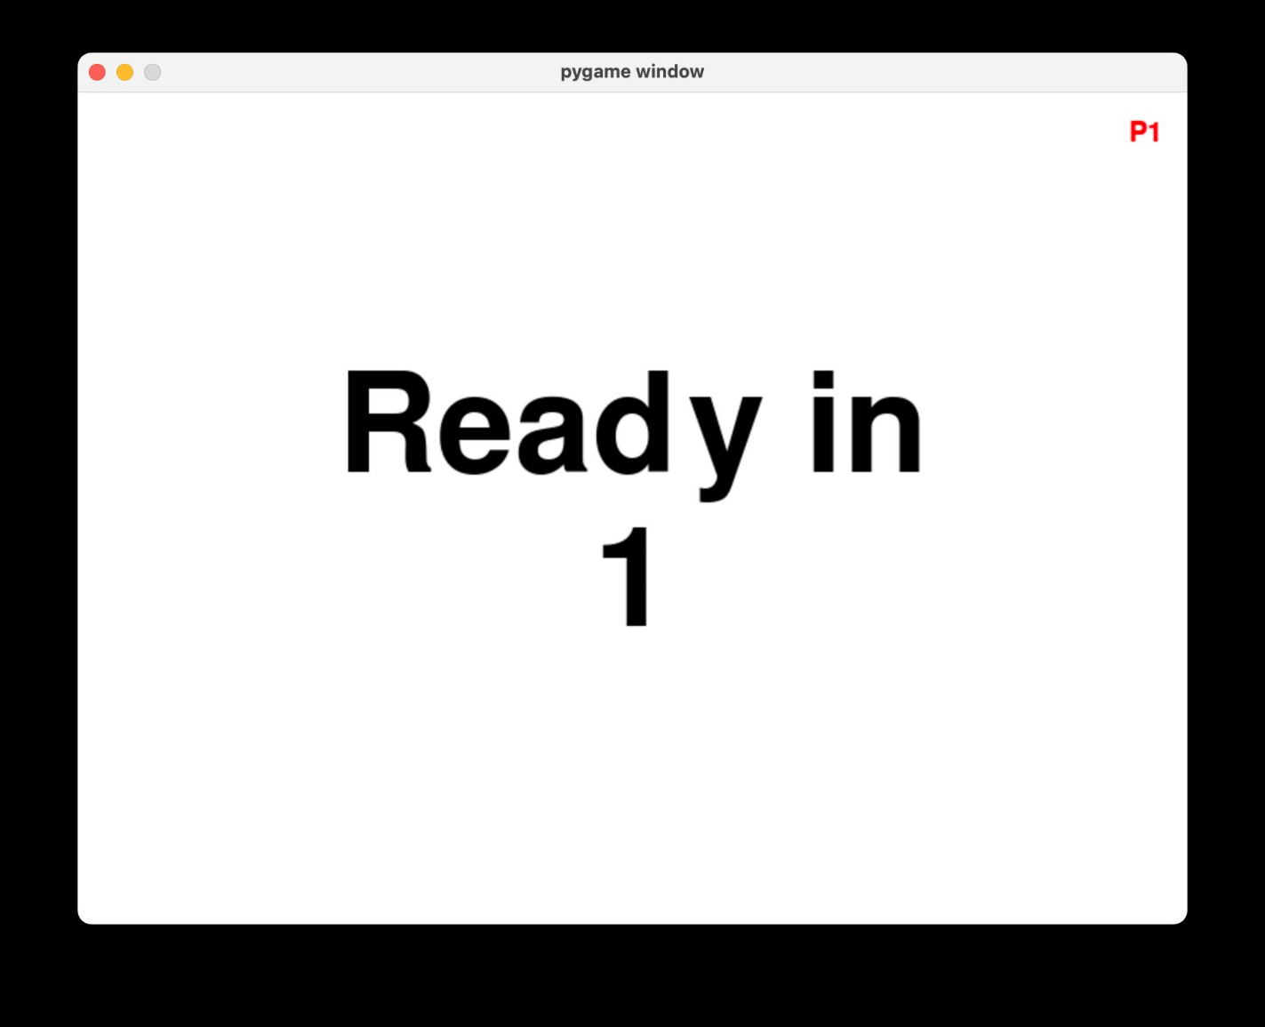
[NAME OF STUDENT]
Mock Screens
Ready In
1
Description
Description
Scoreboard Screen
Ready Screen
6
Notes:
Poppins Light – 18 size

Slide 7
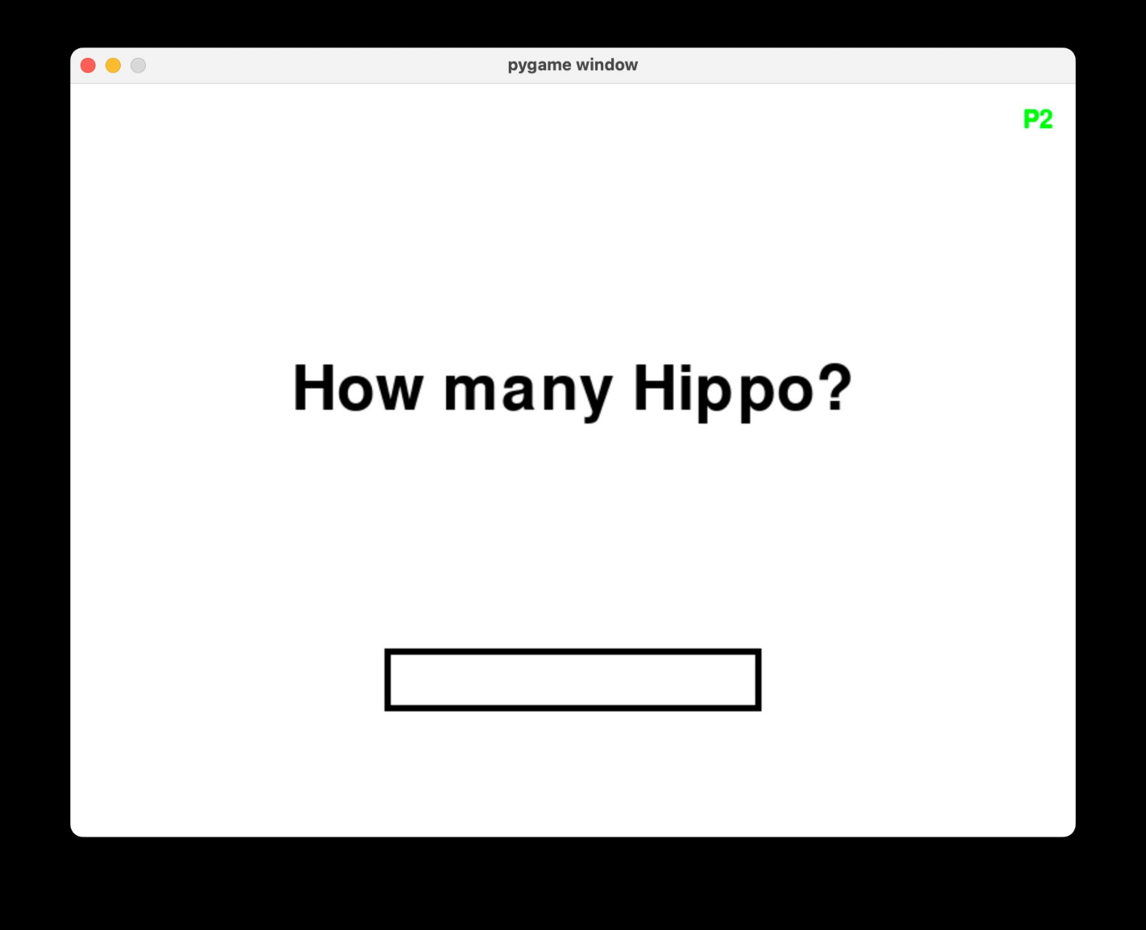
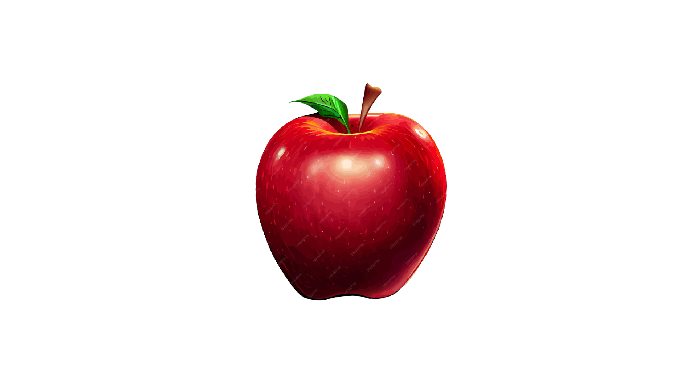
[NAME OF STUDENT]
Mock Screens
Score: 0
Time: 100
Is this an apple?
Description
Gameplay Screen
7
Notes:
Poppins Light – 18 size

Slide 8
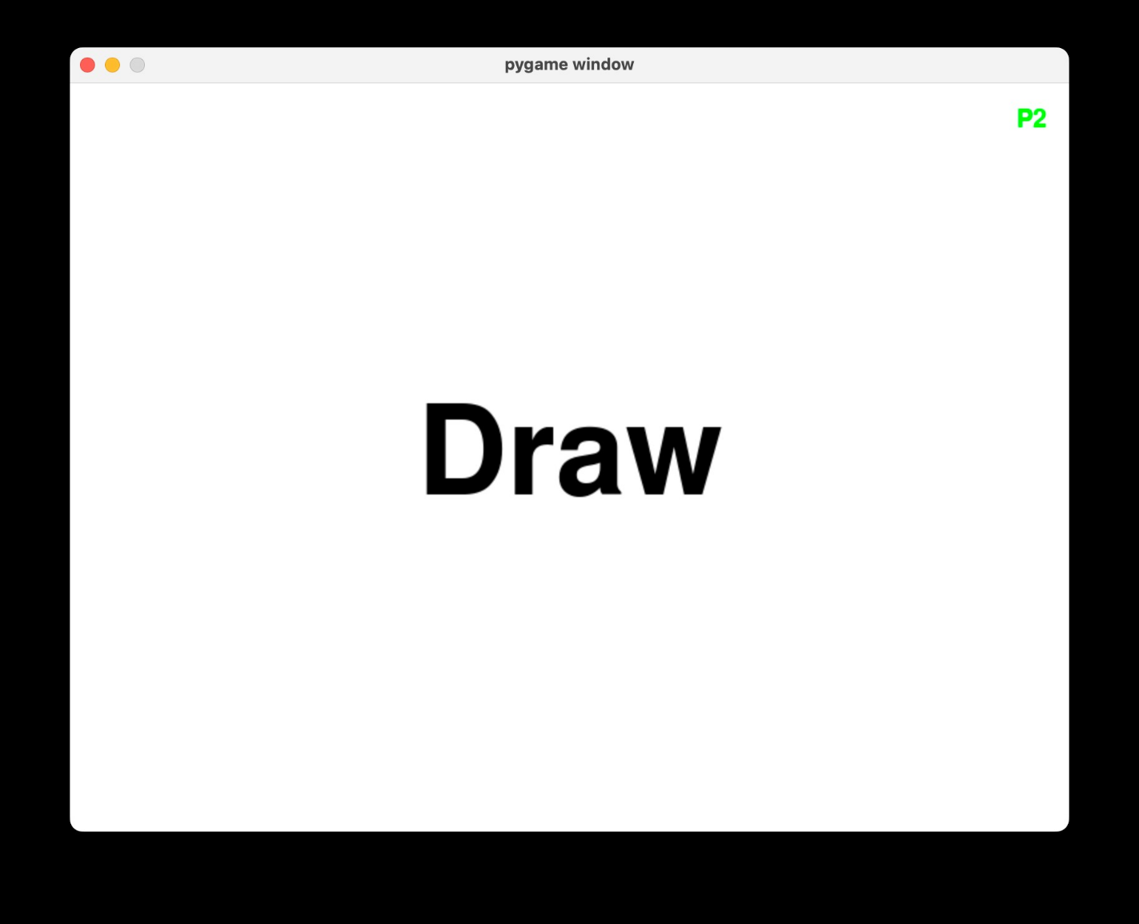
[NAME OF STUDENT]
Mock Screens
You scored 1
Player 1
Wins!
Description
Description
Result Screen
Winner Screen
8
Notes:
Poppins Light – 18 size

Slide 9
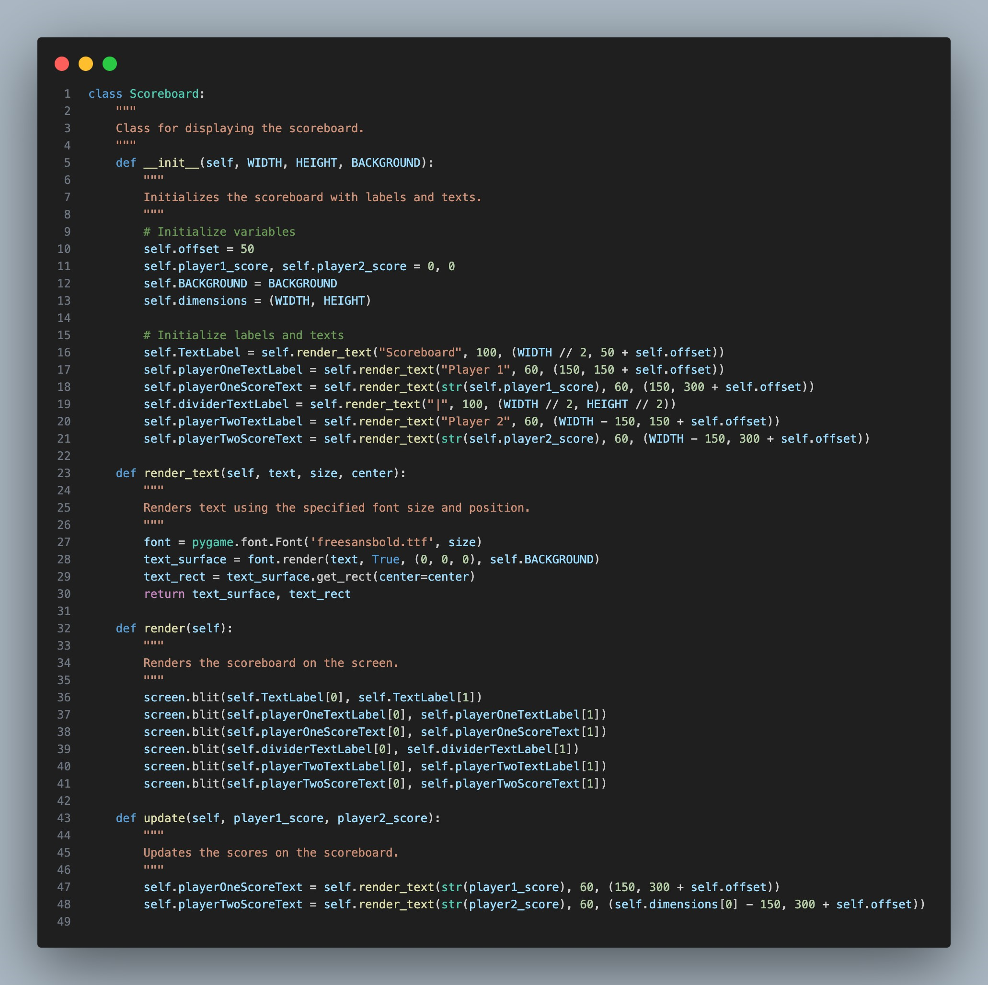
Scoreboard Screen
Displays player scores and labels.
Provides an overview of the current game state.
Elements include player names and their respective scores.
9
Scoreboard Screen
Notes:
Poppins Light – 18 size

Slide 10
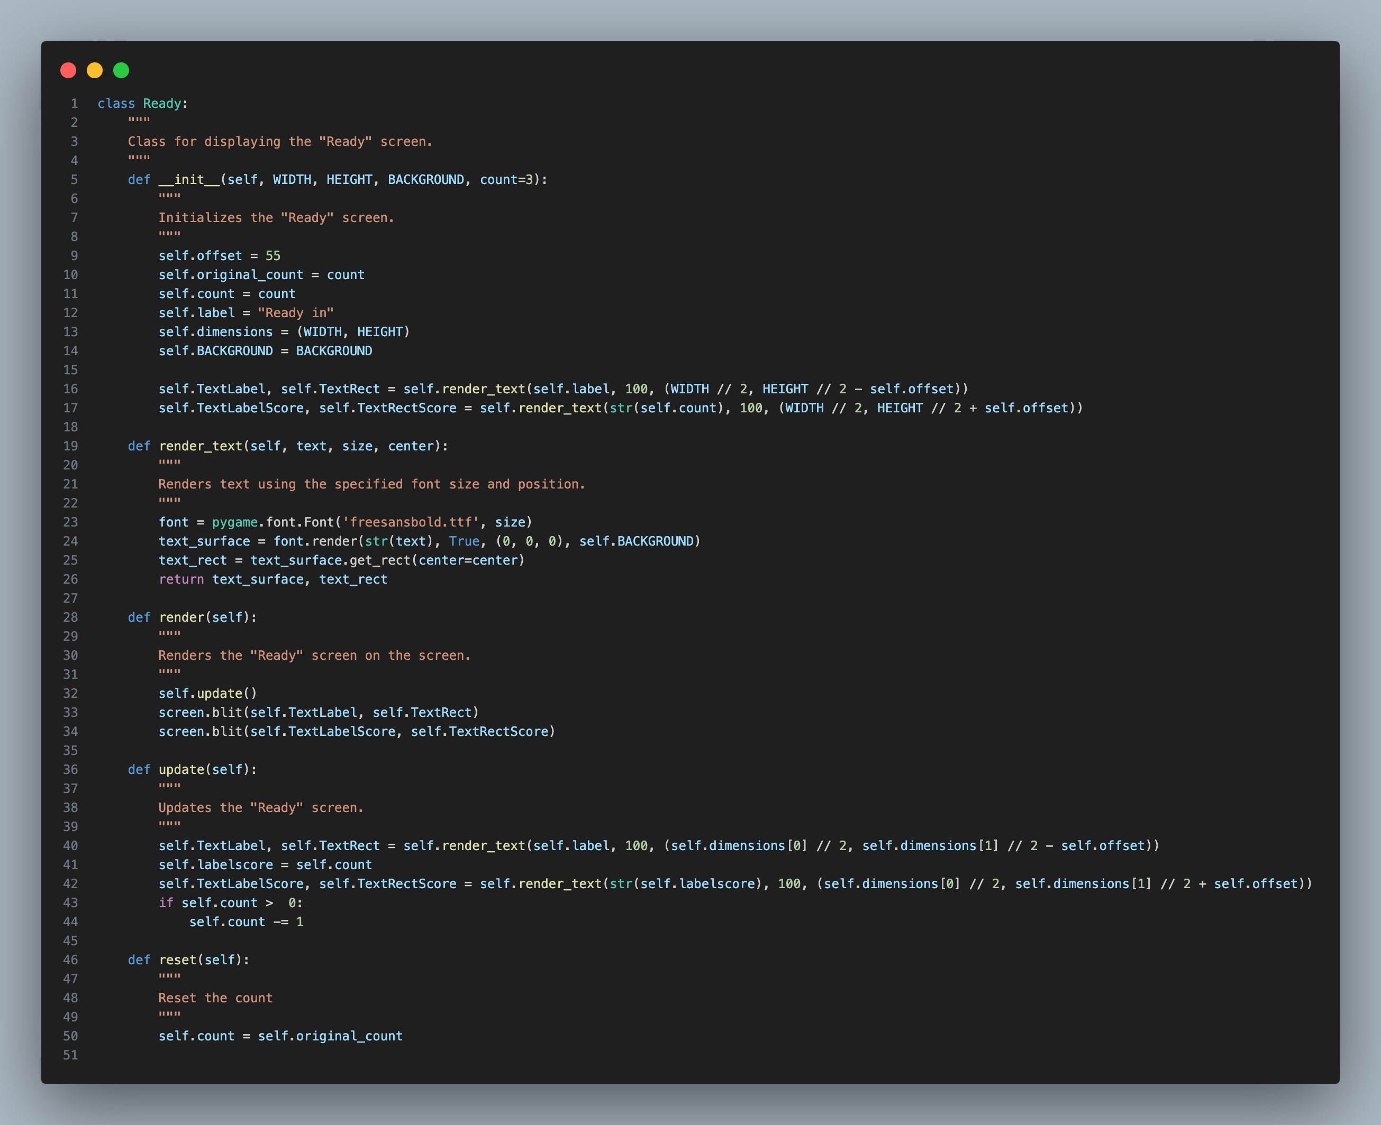
Ready Screen
Counts down to the start of the quiz.
Presents the label "Ready in" and the countdown timer.
Prepares players for the upcoming question.
Ready In
1
10
Ready Screen
Notes:
Poppins Light – 18 size

Slide 11
Y`
Gameplay
If Time Left > 0?
No
0
Loads the next question for every correct response
If wrong answer is given or time runs out, end gameplay.
Yes
No
Is Answer Given?
Yes
Is Answer Correct?
No
Yes
Score: 0
Time: 100
Increase Score by 1
Load next Question
Is this an apple?
Description
Result Screen
11
Gameplay Screen
Notes:
Poppins Light – 18 size

Slide 12
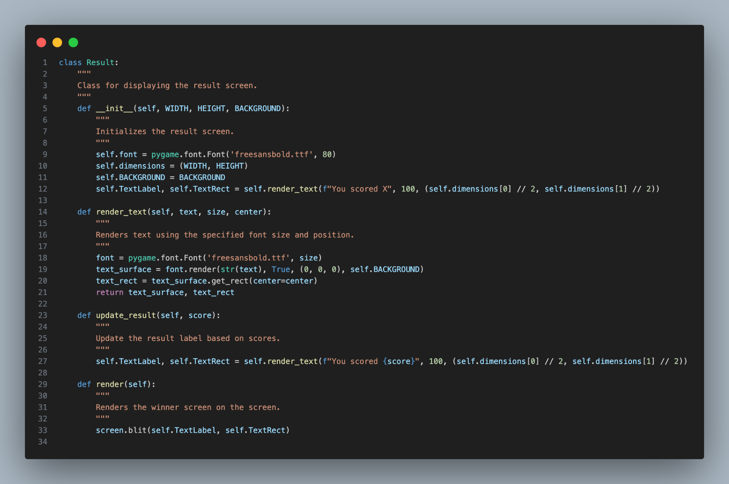
Result Screen
Shows the outcome of the player's answer.
Indicates whether the answer was correct or not.
Presents the label "You scored" and the score.
You scored 1
13
Result Screen
Notes:
Poppins Light – 18 size

Slide 13
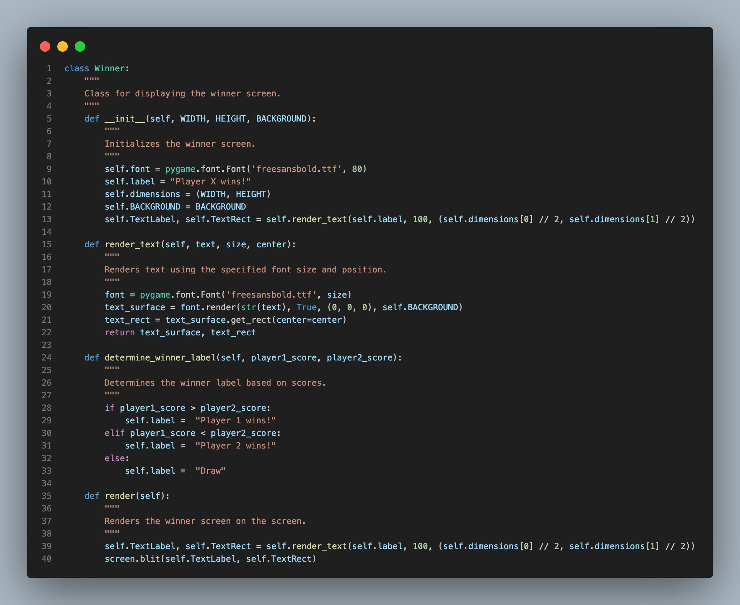
Winner Screen
Declares the winner of the game.
Displays the label "Winner" along with the winning player or a draw message.
Celebrates the victor of the quiz.
Player 1
Wins!
14
Winner Screen
Notes:
Poppins Light – 18 size

